Slide 1


CREATING A RUBBER DUCKY WITH A RASPBERRY PI
PLARD Maël / VIVET Alice / FOURNET Alexandre / Inge2C
04/06/2024

Slide 2


A bit of history…
"It's the struggle between simplicity and security. The power of USB is that you plug it in and it just works. This simplicity is exactly what's enabling these attacks." ​
- Karsten Nohl, 2014

Slide 3


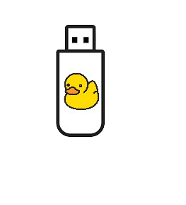


HOW DOES A BadUSB Attack WORKS ?
Rubber Ducky : device that mimics a keyboard to execute pre-programed scripts
USB Killer : Device designed to physically damage computer components by sending an electrical surge.
Keyloggers USB : Device that intercepts and records keystrokes to steal sensitive information.
The attacker plugs the malicious USB inside the victim’s computer
Pre-programed scripts inside the rubber ducky that define the actions that the microcontroller will perform when plugged in
The computer recognizes the Rubber Ducky as a keyboard and executes keyboard inputs programed in the scripts

Slide 4




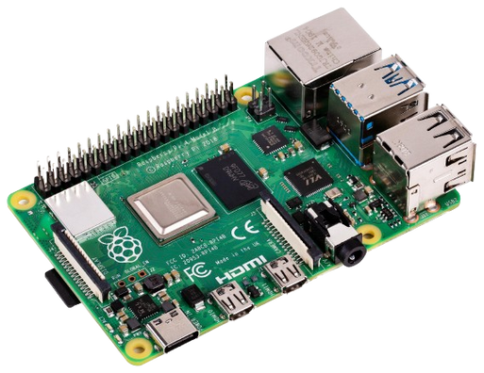

TOOLS AND EQUIPMENTS
Raspberry Pi 4
CircuitPython
Small single-board computer​
4th generation of Raspberry Pi​
Multiples ports : USB, Ethernet, USB-C, HDMI..​
Open-source derivate of Python Language​
Designed to run on microcontrollers
Adafruit HID Library
Collection of function to simulate USB HID.​
Keyboard and Mouse Class

Slide 5

SETTING UP THE RASPBERRY PI
Downloading and installing the image, a complete copy of the data needed, on the SD card​
Adding the Adafruit_hid library
File code.py : where we are going to code the keystrokes
Changing the Keyboard : French layout instead of the US layout

Slide 6


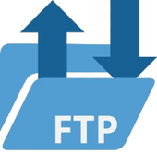


CASE 1 : SENSITIVE DATA THEFT
02
04
Access command prompt to save sensitive databases on victim’s computer
Configure an FTP server to retrieve selected files
Plug the Bad USB to disable antivirus with administrator account
Send databases to the FTP server then delete them from victim’s computer
01
03

Slide 7






CASE 2 : IMPLEMENTING A BACKDOOR
02
Add a rule to the firewall settings which allows us to connect to our remote user from any device
04
Open a terminal with administrator privileges
to be able to modify the registries
Add a user account
and add this user to local administrators group to get all necessary privileges
Disable UAC remote restrictions and hide our user account
01
03

Slide 8
LIMITATIONS
The victim’s computer and the FTP server (or the attacker) must be on the same subnet
Knowing the Operating System and the version the target is using
The session to which the user is connected must have administrator rights

Slide 9

HOW TO AVOID THESE ATTACKS ?
Try to connect computers to known secured networks if possible
Separate the daily account from the administrator account
WIN + L
Rubber Ducky attack cannot be attempted on a locked computer

Slide 10




WHAT DID WE LEARN ?
Explore advanced Windows features and services, such as User Access Control (UAC), WinRM services and temporary folders.
Manipulate a Raspberry Pi and its operating systems, connectivity, flashed images
FTP
Set up and manage an FTP server with Filezilla.

Slide 11




HOW CAN WE IMPROVE OUR PROJECT ?
FLEXIBILITY
SECURITY
Add tests to detect the OS and adapt automatically the payload.
Use a more secure version of FTP to secure the transfer of the stolen files.

Slide 12

DEMO

Slide 13
THANKS
Do you have any questions ?

